Slide 1

AI Recording State Policy
  Please be advised that recording meetings, by any means, including the use of any artificial intelligence (AI) applications, without prior permission is strictly prohibited.
  The use of AI tools, including Read.ai, are prohibited under the Commonwealth’s Gen-AI Guidelines without prior approval by Agency legal counsel. All third-party software must be properly vetted and authorized prior to use.
For ASAP Training Purposes Only.

Slide 2

Microsoft Teams Logistics
Please mute yourself when not speaking
  *6 to mute/unmute if you’re calling in from your phone
Utilize the raise hand feature to identify you would like to speak
Utilize the chat feature to enter comments or questions
Chat side panel
Raise hand
Camera on/off
Participants
side panel
Mute/Unmute
For ASAP Training Purposes Only.

Slide 3
Training Logistics
To limit disruptions, no one will be admitted to the training after 10:45AM
ASAP Representative – enter your ASAP name & the staff who are in attendance into the chat
Calling In
Enter Phone number, ASAP, and Name into chat
For ASAP Training Purposes Only.

Slide 5
AGE Appeals Training

Slide 6
Learning Objectives
Learners will:
Gain an understanding of the background & regulatory requirements of consumer Appeals
Gain an understanding of the purpose of MassHealth Financial Eligibility Appeals in relation to Waiver service authorization
Understand how the ASAP, MassHealth Financial Eligibility for Waiver, and AGE Appeals process supports consumers
Understand how to utilize the ASAP Appeals process as required
Gain an understanding of how accurate documentation supports the ASAP Appeals Process
For ASAP Training Purposes Only.

Slide 7
Agenda
AGE Home Care Program Eligibility
ASAP Appeals Process Overview & Regulations
ASAP Documentation
MassHealth Financial Eligibility for Home Care Waiver Consumers
ASAP Appeals Process
  Appeals Forms and Timeframes
AGE Appeals Process
  Appeals Forms and Timeframes
Case Scenarios
Questions
For ASAP Training Purposes Only.

Slide 8
AGE Home Care Program Eligibility
For ASAP Training Purposes Only.

Slide 9
How do Home Care Appeals relate to Eligibility?
Supporting Documentation
Consumer
Home Care Eligibility
Is the consumer involved in the decision making?
Has a voluntary assent form been discussed?
What is appealable?
Services
Reductions
Terminations
Eligibility
Does the documentation within A&D support the appeal decision?
For ASAP Training Purposes Only.

Slide 10

Home Care Program Eligibility
Age
Function & Need (FIL)
Residence
Service Priority
Method to identify an individual's ADL & IADL functional impairment needs
The degree of functional impairment experienced by an applicant or Consumer
60 +
Resident of MA and living in qualified setting
under 60 with ADRD
Consumer agreement to accept a qualified service for a priority ADL/IADL
For ASAP Training Purposes Only.

Slide 11
ASAP Appeals Process & Regulations
For ASAP Training Purposes Only.

Slide 12
What Happens When a Service Reduction Takes Place?
Home Care Service Reduction or Termination
Consumer Agreement (VAF)
Notice of Action (NOA)
Appeals Forms
ASAP Review
AGE Appeals Hearing
For ASAP Training Purposes Only.

Slide 13


Home Care Appeals and Regulatory Requirements
Right to Appeal:
Applicant/Consumer shall be informed in writing of the right to request a Review of an ASAP's decision to determine ineligibility for Home Care Program applicants as well as reductions/terminations for Home Care Program Services
Applicant or Consumer shall also be informed in writing of their right to Appeal a Review decision to AGE Hearings Officer as specified in 651 CMR 1.07: Initiation of Appeal of a Review Decision
Appeal shall be conducted in accordance with 801 CMR 1.00: Standard Adjudicatory Rules of Practice and Procedure and 651 CMR 1.00: Adjudicatory Rules of Practice and Procedures
For ASAP Training Purposes Only.

Slide 14
Regulatory Requirements for Home Care Appeals
Regulatory Requirement: 651 CMR 3.07 (5) (a) An applicant/consumer shall be informed in writing of his or her right to request a Review, where the ASAP makes a decision to deny, terminate, or reduce Home Care Program Service
For Service Reductions Related to MassHealth financial eligibility: A consumer does not have a right to appeal the reduction/termination of waiver services due to a decision regarding their eligibility for MassHealth
For ASAP Training Purposes Only.

Slide 15
Home Care Appeals Overview
Voluntary Assent
Notice of Action
Changes in Services
Documents consumer’s agreement to change within the service plan or an ASAP decision. Specific service that will be changed shall be identified along with the date & type of change; for example: change in service, reduction or termination. The consumer’s signature documents agreement with the date & change in the service plan
Must be sent, if a Voluntary Assent is not signed, to inform consumer of a reduction/change in services; a termination of services; the effective date of the change; & to provide information on the right to appeal the decision. ASAP must state the specific reason why the change in the service plan has been made & cite the regulation that coincides with the reason for the change. Appeals Rights & Request for Review forms are included with every Notice of Action
Services shall remain at the level in effect, prior to any changes, terminations or reductions, until the ASAP appeal decision & AGE appeal decision (if applicable) is rendered
Notice of Ineligibility
Informs consumer of determination of ineligibility for home care. Appeals Rights & Request for Review forms are included with every Notice of Ineligibility (completed CDS & Financial Assessment required)
Voluntary Assent Forms should be utilized first when possible!
For ASAP Training Purposes Only.

Slide 16
When Can an Applicant Appeal?
Ineligibility for the Home Care Program
An applicant is determined ineligible for Home Care Program due to FIL ineligibility, residency, or age of applicant
Ineligibility for the Home Care Program
Notice of ineligibility shall be documented on a form prescribed by AGE that contain a statement of reasons supporting the finding of ineligibility
Complete CDS & Financial Assessment must be documented within the consumers A&D record
For ASAP Training Purposes Only.

Slide 17
When Can a Consumer Appeal?
Termination of Home Care Services
Reduction of Home Care Services
A consumer is terminated from the Home Care Program due to ineligibility of moving to an ineligible setting, moved out of state, no longer meets FIL criteria, etc.
Home Care Program services are reduced
This is NOT applicable for those consumers that have a reduction due to a loss of MassHealth eligibility
Service plans are changed
For ASAP Training Purposes Only.

Slide 18
Knowledge Check
A consumer has the right to appeal the reduction/termination of Home Care Waiver services due to a decision regarding their financial eligibility for MassHealth.
TRUE OR FALSE
For ASAP Training Purposes Only.

Slide 19
What ASAP Actions are NOT appealable?
An ASAP shall inform the consumer when there has been a change in the source of funding of the consumers services, but the type of and amount of such services remain unchanged
The consumer shall not have the right to appeal a reduction in waiver services to an ASAP as a result of a MassHealth financial determination
Consumers appeal rights are provided by MassHealth
For ASAP Training Purposes Only.

Slide 20
ASAP Documentation Requirements
For ASAP Training Purposes Only.

Slide 21
Documentation that supports the ASAP decision
Journal Entry
CDS & Financial Assessment
Appeals Forms & Regulations
ASAP Appeal Determinations
Consumer/Applicant Appeal
For ASAP Training Purposes Only.

Slide 22
A&D documentation supports the ASAP decision
Comprehensive and timely documentation in the consumer/applicant A&D record supports the ASAP decision subjected to the appeal and ensures alignment with regulatory and programmatic guidance, promoting clear communication, and decision making.
Journal Entry
CDS Assessment
ASAP Determinations
Appeals Forms
Comprehensive, Accurate, and timely reasons for:
Ineligibility
Service reductions/terminations
Completed accurately and timely based on assessed needs
Must support:
Ineligibility
Service reductions/terminations
Must support Regulatory Requirements
Must be supported by Regulatory Requirements
Accurate (Functional Impairment Level) FIL
Provided in accordance with regulatory timeframes
Financial Assessment
Completed accurately and timely based on reported income
For ASAP Training Purposes Only.

Slide 23
ASAP Appeals Process: Notice of Ineligibility
For ASAP Training Purposes Only.

Slide 24
Notice of Ineligibility Process
When an ASAP sends a Notice of Ineligibility (NOI) to the applicant to deny Home Care services it must be accompanied by the List of Appeal Rights to the ASAP and a Request for ASAP Review
ASAPs give the applicant 14 calendar days to appeal ineligibility outlined NOI
Consumer appeals by returning the Request for ASAP Review
For ASAP Training Purposes Only.

Slide 25
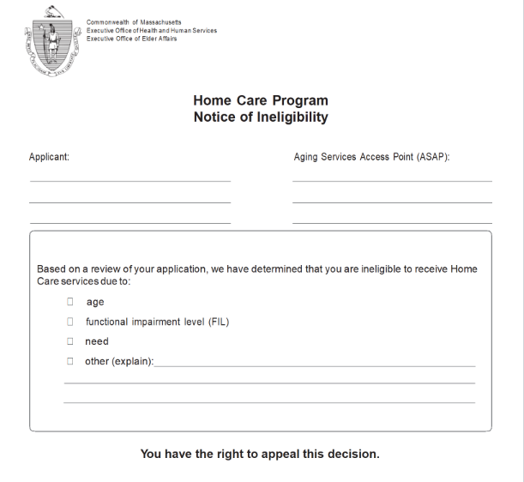
ASAP Appeals Process: Notice of Ineligibility Form
The Notice of Ineligibility Document in all instances when ASAP Staff determine an applicant not eligible for the Home Care Program and is moving forward with notifying them of the reason for ineligibility
ASAPs are required to complete the form in its entirety including:
  Reason: Checking the appropriate box for the assessed reason for ineligibility
  Additional Actions: Send applicant appeal rights and request for review forms
For ASAP Training Purposes Only.

Slide 26

Notice of Ineligibility Form Best Practices
Clear Communication with Applicant
Is the applicant aware of the reason for ineligibility?
Ensure Appropriate Ineligibility Reason
Documentation
NOI decision within A&D
Supervisor/case conference(s) within A&D
Explain to applicant the NOI is coming in the mail and next steps
Review CDS to ensure NOI supports ineligibility determination
Confirm accurate decision noted as the reason for ineligibility
Including rationale for NOI
Communications with applicant regarding the NOI
Case conference with supervisor to discuss accurate home care regulatory requirements are being met
Can the applicant be referred to a different program?
Documentation of referrals (if applicable) to other supports/programs
Documentation is Key
For ASAP Training Purposes Only.

Slide 27
Knowledge Check
What 2 forms MUST accompany the Notice of Ineligibility to an applicant?
Choose the two forms from the options below:
Notice of Action (NOA)
List of Appeal Rights
Voluntary Assent (VAF)
Request for ASAP Review
For ASAP Training Purposes Only.

Slide 28
Voluntary Assent Form
For ASAP Training Purposes Only.

Slide 29

Voluntary Assent Form Process
Documents consumer’s agreement to change within the service plan or an ASAP decision
The consumer’s signature documents agreement with the date & change in the service plan, and the changes are NOT appealable
For ASAP Training Purposes Only.

Slide 30
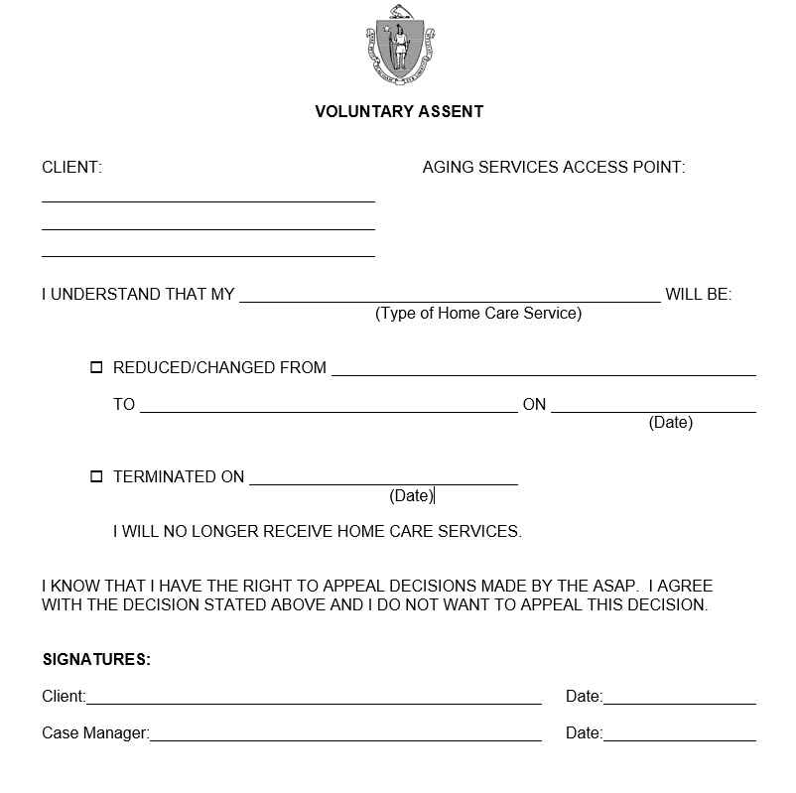
Voluntary Assent Form Example
Documents consumers agreement to a reduction OR termination of services
Specific service that will be changed shall be identified along with the date & type of change; for example: change in service, reduction or termination
The voluntary assent form (VAF) indicates the consumer DOES NOT want to appeal the service changes based on consumer input
Must be dated and signed by both ASAP staff and consumer
The reduction/termination date on the VAF should coincide with the date of the end of the service
For ASAP Training Purposes Only.

Slide 31

Voluntary Assent Form Best Practices
Clear, Person-Centered Communication with Consumer
Is the consumer agreeable to reduce or terminate service(s)?
Explanation of Eligibility
Explain the Home Care eligibility requirements to consumer
Discuss the Voluntary Assent Form
Explain that role and purpose of the VAF
Is the consumer assessed needs causing a reduction of services OR are they ineligible?
Ensure that assessed needs can change over time, and the consumer can engage with the ASAP for services/service reinstatement at any time in the future
Engage with consumer on the rationale and outcome of these service reductions/terminations in relation to their health and welfare and continued program enrollment
ALWAYS keep copies of voluntary assent forms with you to be signed at home visits as needs are identified
Documentation
Document within A&D person centered conversation and consumer agreement of reductions/terminations
Document within A&D supervisor/case conference
Communication is Key
For ASAP Training Purposes Only.

Slide 32
ASAP Appeals Process: Notice of Action Form
For ASAP Training Purposes Only.

Slide 33
Notice of Action Process
When an ASAP sends a Notice of Action (NOA) to the consumer to reduce, or terminate Home Care services, it must be accompanied by the List of Appeal Rights to the ASAP and a Request for ASAP Review
ASAPs give the consumer the following timeframes to appeal the decision(s) stated in NOA:
14 calendar days for non-waiver consumers
30 calendar days for waiver consumers
Consumer appeals by returning the Request for ASAP Review
For ASAP Training Purposes Only.

Slide 34
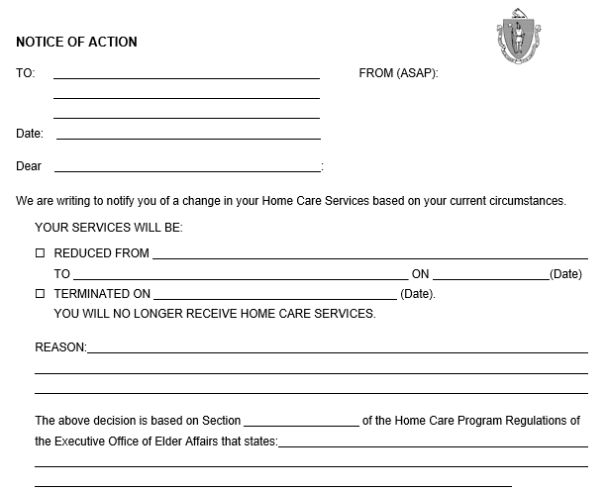
Notice of Action Form
The Notice of Action Document in all instances when an ASAP cannot complete the Voluntary Assent Form and is moving forward with reduction or termination of services
ASAPs are required to complete the form in its entirety including:
  Reason: Outline the purpose why the ASAP is moving forward with the reduction and/or termination of services
  Section: Appropriate Regulation Citation in which the ASAP is using to support the reduction and/or termination
For ASAP Training Purposes Only.

Slide 35
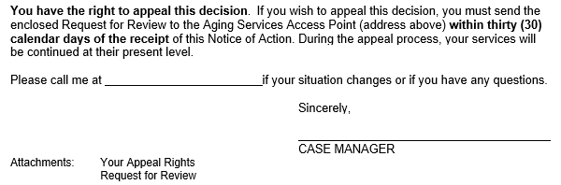
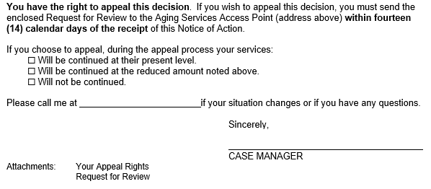
Notice of Action Form: Waiver Versus Non-Waiver Consumers
Waiver Consumers
Non-Waiver Consumers
The Notice of Action has two distinct differences based on the consumers program enrollment
30 calendar days to appeal the decision the ASAP has cited on the form for reduction and/or termination of services for Waivered consumers, and services always continue during the appeal timeframe
14 calendar days to appeal the decision the ASAP has cited on the form for reduction and/or termination of services for Non-waivered consumers
For Non-waivered consumers services should be continued at their present level unless currently suspended
For ASAP Training Purposes Only.

Slide 36

Notice of Action Form Best Practices
Clear Communication with Consumer (when possible)
Is the consumer aware of the changes?
Ensure Appropriate Citations from Regulations
Documentation
NOA decision within A&D
Supervisor/case conference(s) within A&D
Is the consumer able to sign a voluntary assent form?
If possible, let the know consumer/family know this is coming and requires a signature and return to ASAP
Review CDS and care plan to ensure NOA best fits the situation
Confirm regulatory citations are correct for the type of service change
Including regulations and reason for NOA
Communications with consumer regarding the NOA
Case conference with supervisor to discuss accurate home care regulation citation supports the NOA decision
Confirm use of correct Notice of Action based on enrollment
Documentation is Key
For ASAP Training Purposes Only.

Slide 37
Knowledge Check
An ECOP consumer indicates at assessment they no longer want Home Delivered Meals. Which of the following forms, indicating consumer choice, should be signed by the consumer at the visit?
Notice of Action (NOA)
List of Appeal Rights
Voluntary Assent (VAF)
Notice of Ineligibility
For ASAP Training Purposes Only.

Slide 38
MassHealth Financial Eligibility for Home Care Waiver Consumers
For ASAP Training Purposes Only.

Slide 39
Waiver Guidelines
When a participant’s MassHealth coverage changes due to a decision made by MassHealth, MassHealth provides participant the opportunity to appeal that decision. The appeal process shall be completed prior to submitting the Notice of Non-Participation to the MassHealth Member Enrollment Center (MEC)
Home Care Waiver Participants:
When terminating or reducing waiver services, the ASAP shall issue a Voluntary Assent Form (VAF) and ask the participant to sign and return it to the ASAP
If a signed VAF is not received from the participant, a Notice of Action (NOA) is required according to 651 CMR 3.07. In accordance with 651 MR 3.07 (4)(b) a waiver participant has 30 days after a Notice of Action is sent to appeal the reduction or termination of waiver services by requesting an ASAP review. If the waiver participant files a timely request for review, the ASAP shall, in accordance with 651 CMR 7.08 (2), either continue the suspension or continue the provision of FEW services during the Review and Appeal period, as appropriate
If participant is ineligible for MassHealth Standard, a VAF or NOA is not required. As with other MassHealth service types, waiver services may not be provided to persons ineligible for MassHealth. The participant has an opportunity to appeal MassHealth’s decision regarding their financial eligibility for MassHealth. The participant does not have a right to appeal the termination of waiver services due to a decision regarding their eligibility for MassHealth
For ASAP Training Purposes Only.

Slide 40
Appeals Forms and Documents
For ASAP Training Purposes Only.

Slide 41
Important Appeals Documents
ASAP’s are required to send important documents to consumers who receive either:
NOI and NOA Forms
List of Appeals Rights
Request for ASAP Review
Explains the consumer/applicant rights for a review of the decision
Explains how the consumer/applicant can appeal the decision
Form to be completed by the consumer/applicant and sent back to the ASAP
Outlines the reason for the review, location of review meeting, and who to contact to discuss the ASAP review
For ASAP Training Purposes Only.

Slide 42
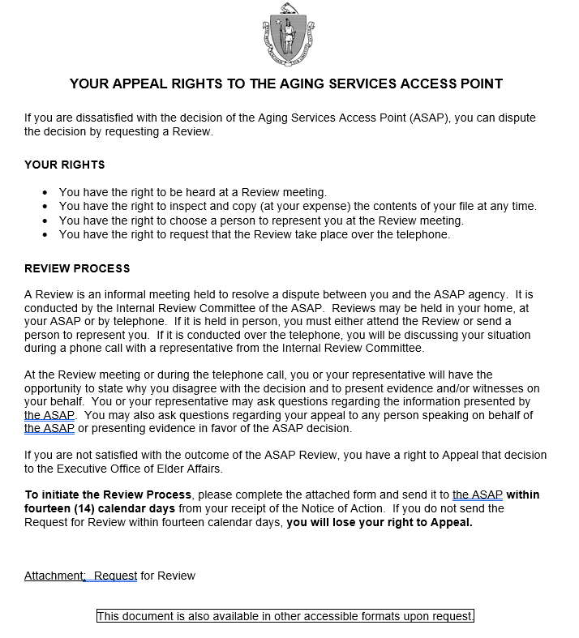
List of Appeal Rights
Consumer/applicant rights
How the appeal the decision
For ASAP Training Purposes Only.

Slide 43
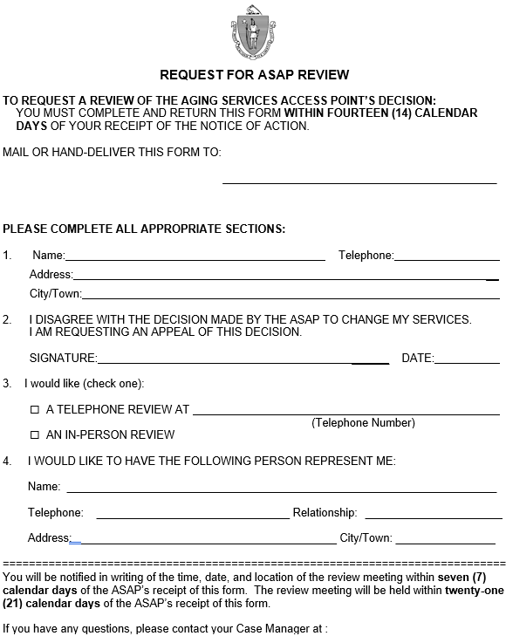
Request for ASAP Review
Completed by consumer/applicant sent back to the ASAP
Explains reason for the review
Returned to ASAP
Location of review meeting
Consumer/representative to contact to discuss the ASAP review
For ASAP Training Purposes Only.

Slide 44
ASAP Appeal Process: timeframes for communications
Once the consumer/applicant returns the Request for ASAP Review to the ASAP, the ASAP has 7 calendar days to schedule a review and notify the consumer of the date and time of hearing.
Utilizing the Notice of ASAP Review Date, which is mailed to the consumer/applicant
The ASAP has 21 calendar days to respond to the consumer/applicant
For ASAP Training Purposes Only.

Slide 45
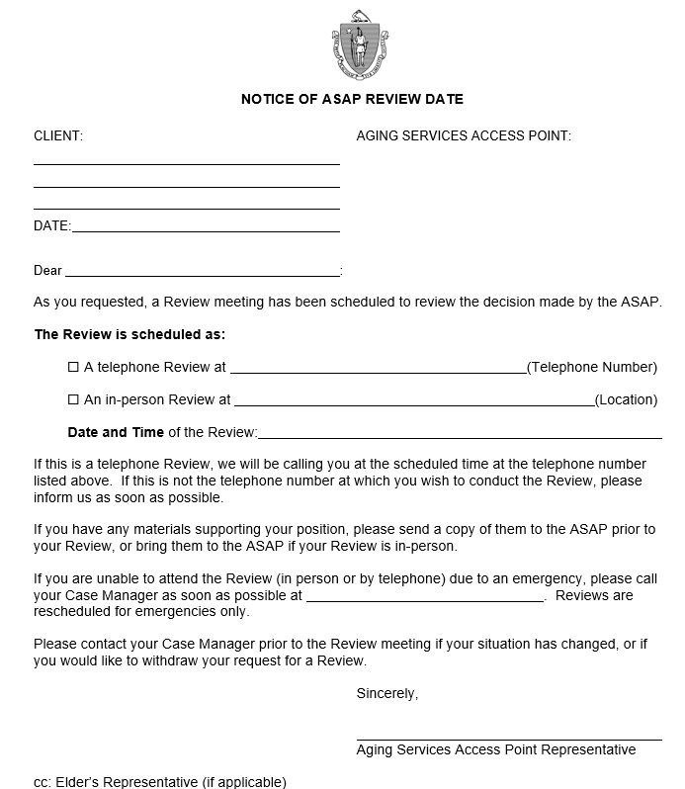
Notice of ASAP Review Date
Notice of ASAP Review Date Form
Required to be sent to consumer/applicant within 7 days of receiving the request for ASAP Review form
Communicates Date, Time and Location of the Meeting
Description of what materials to bring to the ASAP review meeting
For ASAP Training Purposes Only.

Slide 46
ASAP Appeal Process
The ASAP has 7 days after the meeting to render a decision based on the ASAP Review meeting
The ASAP has 21 calendar days to respond to the consumer/applicant
Once the ASAP Review has concluded, a determination is made the ASAP shall send a Notice of ASAP Review Decision to the consumer. Two forms must accompany this ASAP decision:
Appeal Rights to AGE (Elder Affairs)
Request to Appeal ASAP’s Review Decision
The consumer/applicant then has the option to Appeal to an AGE Hearing Officer within 14 days, (30 days for Waiver consumers) of receiving the Notice of ASAP Review Decision
For ASAP Training Purposes Only.

Slide 47
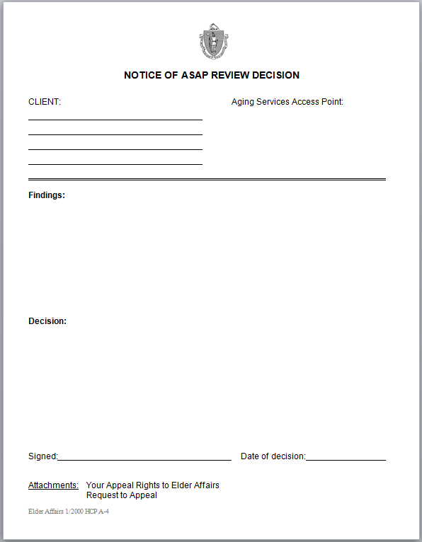
Notice of ASAP Review Decision
Completed by ASAP staff
Mailed to consumer/applicant
File attachment in A&D Record
Explains ASAP decision
For ASAP Training Purposes Only.

Slide 48
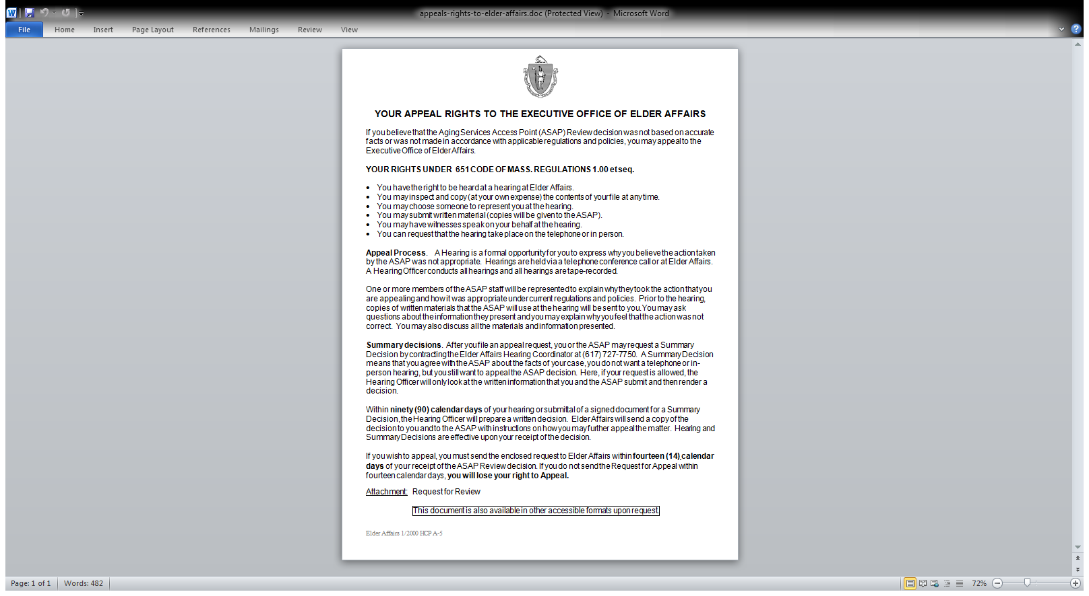
Appeal Rights to AGE (Elder Affairs)
Consumer/applicant rights
How to appeal the ASAP decision to AGE
Regulatory Requirements
For ASAP Training Purposes Only.

Slide 49
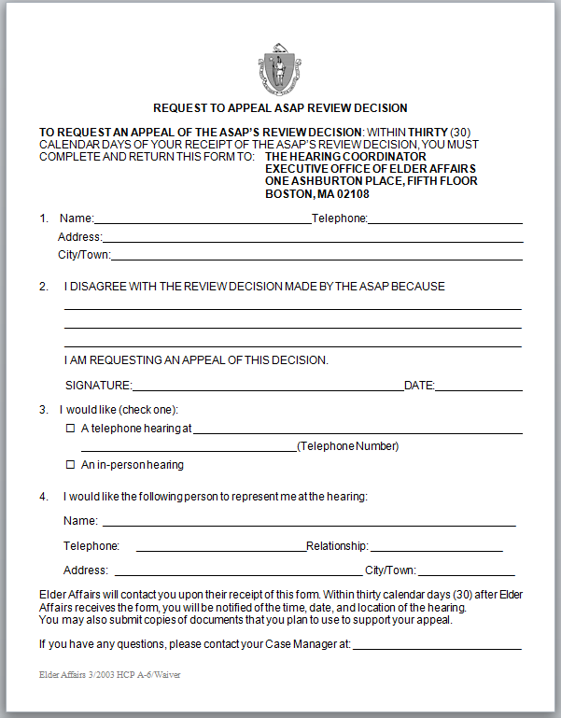
Request to Appeal ASAP’s Review Decision Form
Completed by
consumer/applicant
Consumer/applicant mails to AGE
Explains consumer/applicant reason for appeal
For ASAP Training Purposes Only.

Slide 50
Knowledge Check
Once the consumer/applicant returns the Request for ASAP Review to the ASAP, the ASAP has how many calendar days to schedule a review and notify the consumer of the date and time of hearing?
2 calendar days
7 calendar days
5 calendar days
14 calendar days
For ASAP Training Purposes Only.

Slide 51
AGE Appeals Process
For ASAP Training Purposes Only.

Slide 52
AGE Appeal Process and Timeframes
Within 30 days of receiving the Appeal Request, AGE will offer the consumer a hearing date either in-person or by phone with the hearing officer. If necessary, the time period may be extended
Hearing Officer will have 60 days from the hearing date to make decision. Extenuating circumstances provide up to 90 days
Upon decision, AGE will forward decision to the ASAP and consumer/applicant
AGE staff review consumer/applicant record, connect with ASAP, pull A&D record documents, as well as regulatory & sub-regulatory guidance as needed & share with hearing officer
The hearing is held with consumer/applicant and representatives (when applicable) as well as ASAP staff to review all pertinent information related to the appeal
For ASAP Training Purposes Only.

Slide 53
Role of the AGE Hearing Officer
Independent of AGE
Designated by the Secretary
Schedules & conducts Appeal Hearing(s)
Rules on Motion(s)
Renders decision(s) on Appeals
Hearing officer reviews consumer record & regulatory/program guidance
For ASAP Training Purposes Only.

Slide 54
Subsequent AGE Appeal Process
801 CMR 1.00: Standard adjudicatory rules of practice and procedure outline further appeals process to:
The Division of Administrative Law Appeals (DALA)
DALA provides a neutral forum for hearing any case in which one has the right to appeal the decision of another state agency
For any decision adverse to the consumer/applicant, DALA shall send the consumer a copy of the decision with a notice informing the Petitioner of their right to appeal
Consumer/applicant must make a written request for appeal within 15 days of the date DALA mailed the notice
Consumer/applicant must send the written request for hearing to DALA
Consumer/applicant must ask for a new hearing
For ASAP Training Purposes Only.

Slide 55
ASAP Appeals Case Scenarios
For ASAP Training Purposes Only.

Slide 56

Case Scenario 1
Applicant is 76-year-old English speaking female living alone in private home in Taunton
Applicant also reported that her family assists with cleaning 1x month
Reports she goes out every day for activities & only needs help with cleaning
Is applicant eligible for the Home Care Program?
No - 4NC
Does not have a critical unmet need or require assistance with any ADL or sufficient IADLs and is determined not eligible for Home care
For ASAP Training Purposes Only.

Slide 57
Case Scenario 1 Continued
What Next?
CM Discusses assessment and ineligibility with applicant & Supervisor
Mail Notice of Ineligibility & Appeal Rights as applicant is ineligible for Home Care services
CM’s documentation supports mailing of Notice of Ineligibility & Appeals Rights
Complete Notice of Ineligibility citing accurate reason and regulation for ineligibility
CM’s documentation supports explanation of ineligibility & appeals process
For ASAP Training Purposes Only.

Slide 58
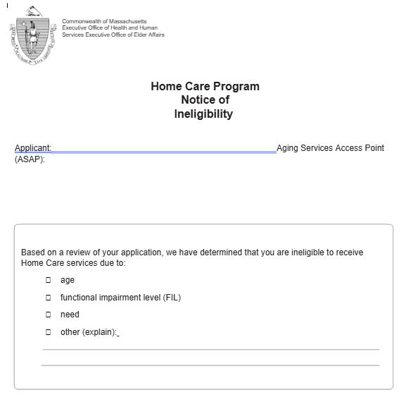
Completing the Notice of Ineligibility Form
For ASAP Training Purposes Only.

Slide 59
Case Scenario 1 Continued
14 calendar days later, Applicant returns the Request for ASAP Review Form
ASAP mails the completed Notice of ASAP Review Decision to applicant
ASAP Review meeting upholds the original ineligibility determination
Within 7 calendar days ASAP sets up Review Meeting with Applicant
ASAP also mails the: Appeal Rights to AGE
Request to Appeal ASAP’s Review Decision
ASAP documents outcome of Review meeting within consumer record
For ASAP Training Purposes Only.

Slide 60

Case Scenario 2
Consumer is 62-year-old English speaking female living alone in subsidized apartment in Springfield who receives assistance with personal care & homemaking
Consumer also reports that her family pays privately for a laundry service
Reports to CM that she is feeling better after her surgery, and no longer requires assistance with bathing
Consumer reports that she no longer wishes to receive services through the Home Care Program
What Next?
For ASAP Training Purposes Only.

Slide 61
Completing the Voluntary Assent Form
Ms. Smith
Personal Care & Homemaking
April 1, 2026
For ASAP Training Purposes Only.

Slide 62
Case Scenario 2 Continued
Discuss assessment with consumer at home visit, explain VAF & purpose
CM’s documentation supports termination & signed VAF
Consumer signs VAF & indicates desire to terminate from the Home Care Program
CM explains that consumer can re-apply if any needs change in future
VAF is maintained as part of consumers’ supplemental file
For ASAP Training Purposes Only.

Slide 63

Questions or Comments
For ASAP Training Purposes Only.

Slide 64
Thank you!

