Slide 1







Executive Office of Elder Affairs
RESPECT INDEPENDENCE INCLUSION
Pending Service Referral
& Provider Search
Tuesday, September 28th, 2021

Slide 2
Pending Service Referral & Provider Search
AGENDA
  What is Pending Service Referral & Provider Search?
  Development
  Pilot
  New Process
  Reporting
  Q & A

Slide 3
Pending Service Referral & Provider Search
A new state-wide process for service referral management:
  Consistent
  Universal
  Track referrals by consumer, by service, duration of pending status
  Report on pending referrals for internal and external utilization
    Contracting, Quality, Case Management
    Send to Providers as a “referral list”
Standardized way to track pending service referrals in SAMS
  Within consumer record
  Within care plan
  Utilizing a specific “- Pending” service type
  Specific pending services:
    Chore, Companion HM, PC, HHA, SHCA

Slide 4
Pending Service Referral/ Provider Search – Development
Past exploration by a few ASAPs on service plan statuses to indicate consumers were “waiting” for a service to start
Guiding Principles:
  Create a process familiar to ASAPs based on existing tasks
  Understand processes already attempted and lessons learned
  Leverage fields that are primarily pre-determined “pull-down” vs free text
  Must include reporting functionality for ASAPs to share referral details with Providers as a referral communication method
  Aid in telling the story of consumers being served

Slide 5
Pending Service Referral/ Provider Search – Pilot
2 ASAP pilots since December 2020
  BayPath Elder Services
  Tri-Valley Elder Services
Pilot agencies were selected:
  as they had an existing process already in place
    Excel or Activities & Referrals process
    Expressed interest in exploring new option
1 additional ASAP added for July 2021
  Aging Services of North Central Massachusetts

Slide 6
Pending Service Referral/ Provider Search – New Process
Business Rule outlines new process shared 9/24/2021
Provider: Unknown Provider/Referral Pending
  Chore – Pending
  Companion – Pending
  Homemaker – Pending
  Home Health Aide – Pending
  Personal Care - Pending
  Supportive Home Care Aide – Pending
Subservices to identify and track service factors:
  Consumer has Pets
  Consumer is Smoker
  Consumer has Pets & is Smoker
  Preferred Language
  Requests Female Only
  Requests Male Only
  Rural Location

Slide 7
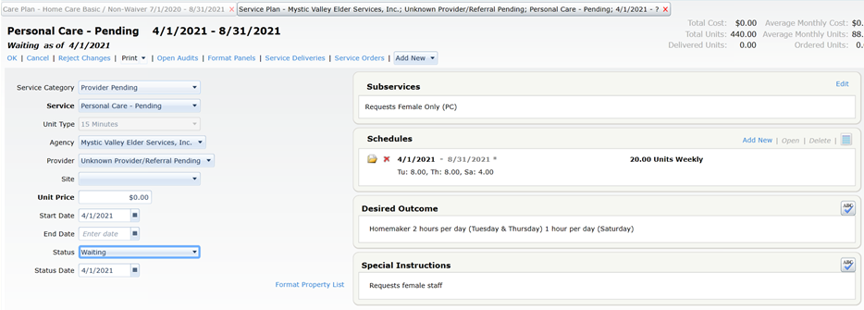
Pending Service Referral/ Provider Search – New Process
Service Plan Fields (on the left):
Service Category: Provider Pending
Service: Must choose a service with “- Pending” in title
Agency: ASAP Name
Provider: Unknown Provider/Referral Pending
Start Date: The start date of the service referral
End Date: Blank
Status: Waiting
Status Date: The start date of the service referral (this field will be helpful should the care plan need to be copied as part of an annual review)

Slide 8
Pending Service Referral/ Provider Search – New Process
Service Plan Fields (on the right):
Subservice: Will populate automatically if subservice is selected in the schedule
Schedule:
should be allocation type weekly
do not use monthly or duration specified
should include subservice when appropriate.
Daily Details should be entered when consumer has specific preference, can be left blank when consumer does not have preference.
Desired Outcome: Free text field available to track notes (will appear in report)
Special Instructions: Free text field available to track notes (will appear in report)

Slide 9
Pending Service Referral/ Provider Search – New Process
Pending Service Plan process should be used:
  Any time the consumer is authorized for any of the 6 in-home services
  Any time the consumer is authorized for multiple in-home services
    Example: Chore and Personal Care
  Any time the consumer is partial filled for service, but still has hours unfilled
    Example: Needs 2 days/week (Sat & Sun), has Sat (filled), but still needs Sun (unfilled)

Slide 10
Pending Service Referral/ Provider Search - Reporting
HAR Reporting Available
  Statewide totals of consumers pending
  Provider facing report
  ASAP summary of consumers pending
  ASAP summary of consumer pending by zip code
Report Description & User Guide shared 9/24/2021

Slide 11
Pending Service Referral/ Provider Search - Reporting
• ASAP – Incorporate service referral management into ASAP Policies & Procedures:
include utilization management protocol for different roles and uses of reports including, but not limited to:
  Care Management
  Service Procurement
  Quality Management
  Supervision and Program Management
reflect appropriate frequency for running reports
• EOEA – Frequent reporting and oversight:
Minimum of monthly reporting
Network Analysis and Summary
Service, referral and data management and engagement with ASAPs

Slide 12
Questions?

